Slide 1

Libby Sinclair
President
The Level, City SU | 13/11/2025 | 18:00 – 20:00

Slide 2

House Keeping
Toilets
Emergency Exits
Appointment of Vice-Chair

Slide 3

Attendees
Chair Person
Libby Sinclair | President
Executive Officers
Mischa Dooley | VP Education
Ryan Turner | VP Postgraduate
Ben Parker | VP Opportunities
Joe Cormack | VP Community and Welfare
Jasmyn Smith | VP Sport
Paige Skelland | Brackenhurst Officer
Campus Officers
Della Pinnock | Mansfield Officer

Slide 4
Apologies

Slide 5
Staff Protocols
Members should note that reference should not be made to any member of NTU or NTSU staff, as they do not have right to reply.
This applies in all reports and the conversation in the meeting.
Staff in attendance are here at the invitation of the President in a support capacity.
Any information they provide will be factual only, and they will not participate in any vote.

Slide 6
Agenda
Apologies
Agenda
Staff Protocols
Minutes
Reports
NTSU Impact Report
Finances
Affiliation
NTSU Officer Review
Any Other Business (AOB)
Future Meetings

Slide 7
Minutes
The minutes of the previous Annual Meeting is pending ratification by this meeting. The document can be found at: 2024_11_21_UMMinutes.docx

Slide 8

Report – Executive Team
Completed a thorough two-week induction period.
Lead, trained and recruited 200 Freshers Team volunteers who helped support our events and move ins during fresher's week.
Maintained NTSU presence in all summer Graduations.
Engaged in Mental Health First Aid training, Antisemitism training, Safe Space Pledge Training, Anti-Islamophobia training.
Successfully undergone training to become Consent is Everything Facilitators.
Attended NUS Lead and Change.

Slide 9
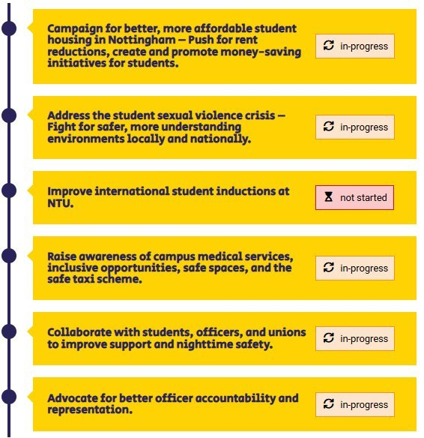
Report – Libby Sinclair
Worked with the Consent Team to develop SV Disclosure training for Exec.
Became a member of NTU Board of Governors- in depth training and Student representative conference in London.
Updated and improved the Freshers Team programme, increasing time off and incentives for both officers and volunteers, organising two social nights.
Wrote papers for university committees and presented updates and priorities of all the officers at the highest level of the University.
Met with the New Vice Chancellor of the University to introduce him to NTSU and what we do on his first day.

Slide 10
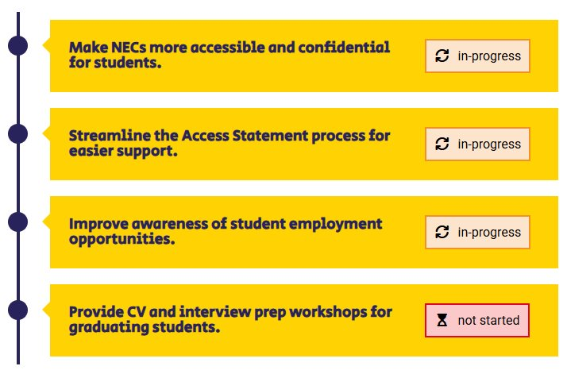
Report – Mischa Dooley
Focus groups for Access statements and Extensions – working with students to see where they would prefer to have access to accessibility help on the NOW page.
Course Rep and School Officer inductions – helping to induct over 600 throughout October.
Working with Employability – collaborating with Employability to increase awareness and provide engaging and informative workshops.
ACL APP project (Active Collaborative Learning Access participation Plan) Academic Workstream group focusing on expansion of the SCALE-UP and TBL across all schools, working collaboratively throughout the year.
Visited the NTU London Campus to engage with students and find out more about their experiences.

Slide 11
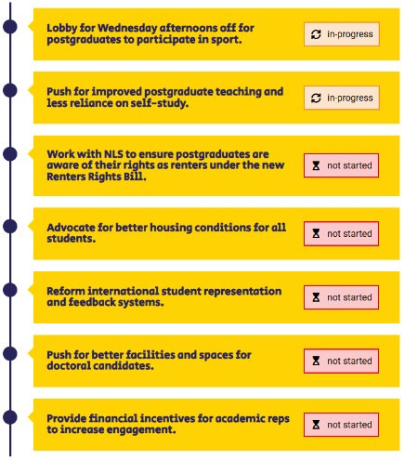
Report – Ryan Turner
Meetings with NTU timetabling to see what courses are taught on Wednesday afternoons and reviewed the policy on timetabling for PGT.
Conversations with Nottingham Law School staff to suggest a poster that outlines the rights as a renter under the new Renters' Rights Bill.
Course reps and School officer interviews and inductions.
Advocated for better housing during the fresher's period in regard to issues that were brought to my attention during the period.
Engagement with international student events and committees.

Slide 12
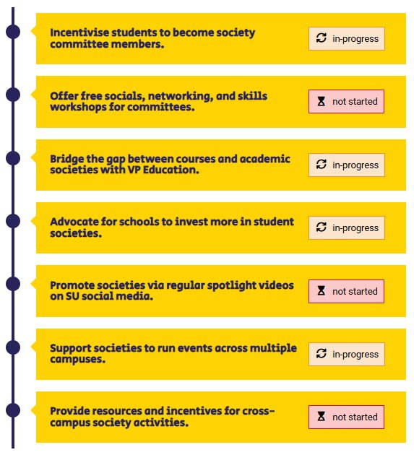
Report – Ben Parker
Held the first Society Assembly of the academic year.
Hosted events in both City and Clifton Global Lounge.
Working with senior members of the University to support academic societies.
Hosted a focus group on Mansfield with first year students.
Created and opened an application form for the upcoming Trent's Got Talent.

Slide 13
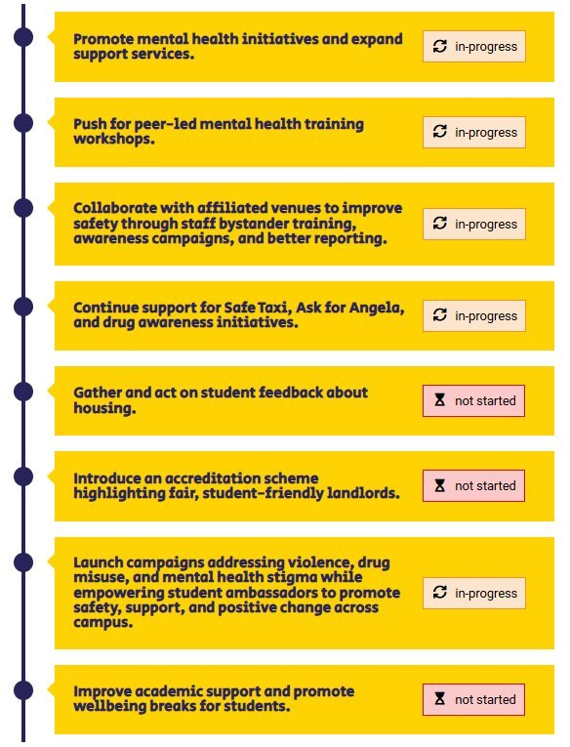
Report – Joe Cormack
Working around night time safety, looking at improving the Safe Space Pledge.
I have been elected as a member of NUS Democratic Procedures Committee.
I have been working on campaigns for EDI celebration and awareness days.
I have been working alongside the University to explore ways in which we can reach students who are harder to reach than your average student.
Myself and the and VP Sport have been working on developing peer-led mental health training.

Slide 14
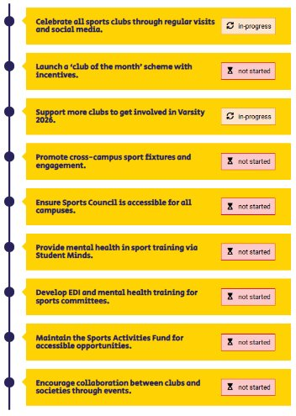
Report – Jasmyn Smith
I was elected as BUCS Student Officer over summer at Conference 2025.
Worked with UON sports officer to change the way the Varsity strategic management board operates to support the series.
Helped to deliver committee training with NTU Sport in September.
Supported NTU Sport clubs throughout tasters and tryouts (and got to try some new things myself!)
Helped to appoint the new Head Coach of NTU Cheerleading.

Slide 15
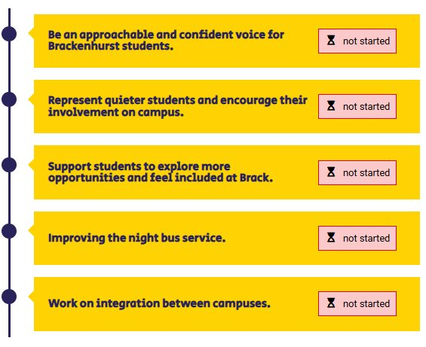
Report – Paige Skelland
Led the Brackenhurst freshers' team, welcomed new students on to campus
Spoke to societies at fresher's fair asking them about their plans for students at Brack and how they are planning to involve them
Completed a two week induction period so I am knowledgeable in my role
Filmed a Brack tour for students wondering what we have to offer
Hosted and attended events at Brack bar so Brackenhurst students feel comfortable to talk to me about any issues they may have

Slide 16
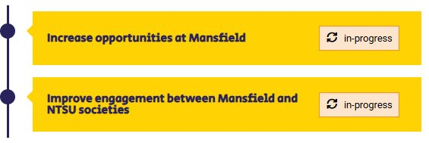
Report – Della Pinnock
Spoken at Mansfield Matriculation in September.
Hosted Mansfield Talks, alongside Ben, the VP Opportunities.
Ran a stall at an event known as Afternoon at Mansfield.
Ran a stall at the wellbeing event at Mansfield in October.
Attended various meetings where I have represented the students on the site.

Slide 17
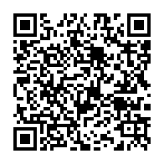
NTSU Impact Report

Slide 18
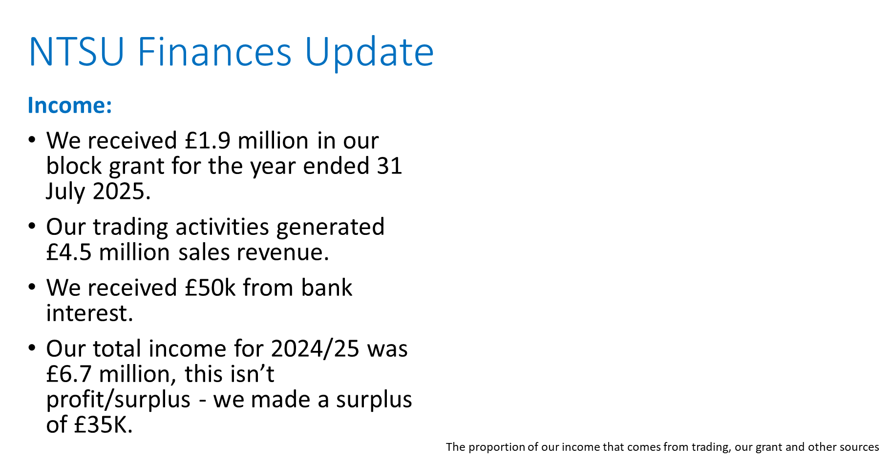
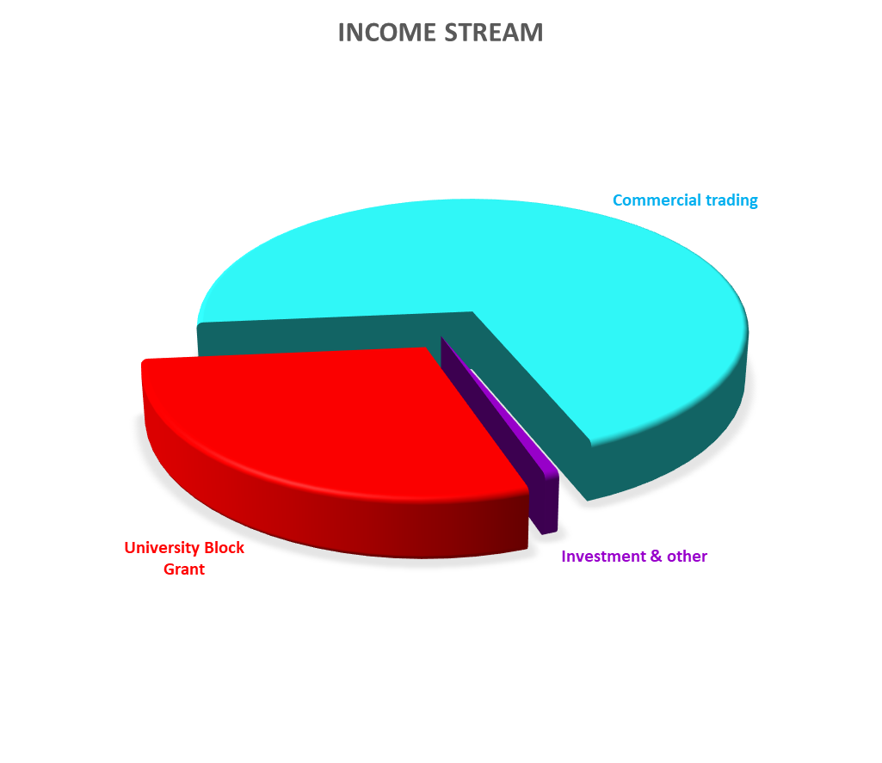

Slide 19
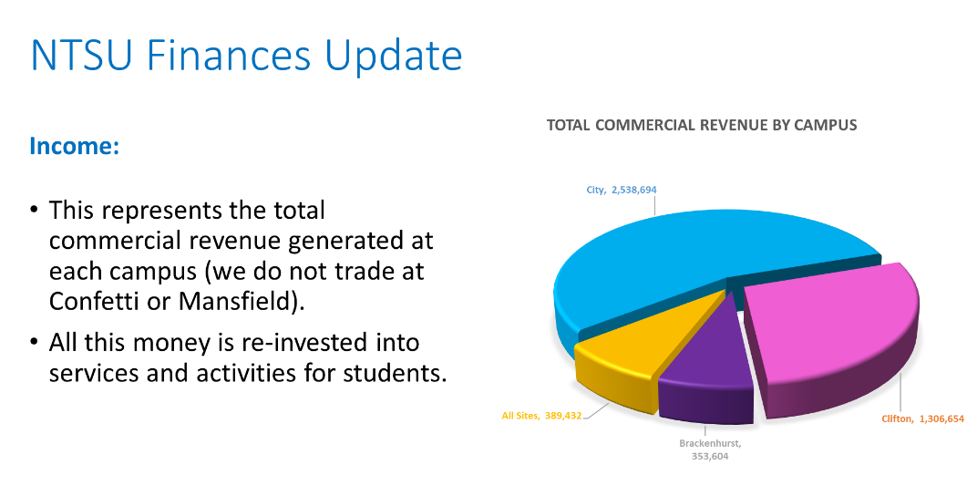

Slide 20
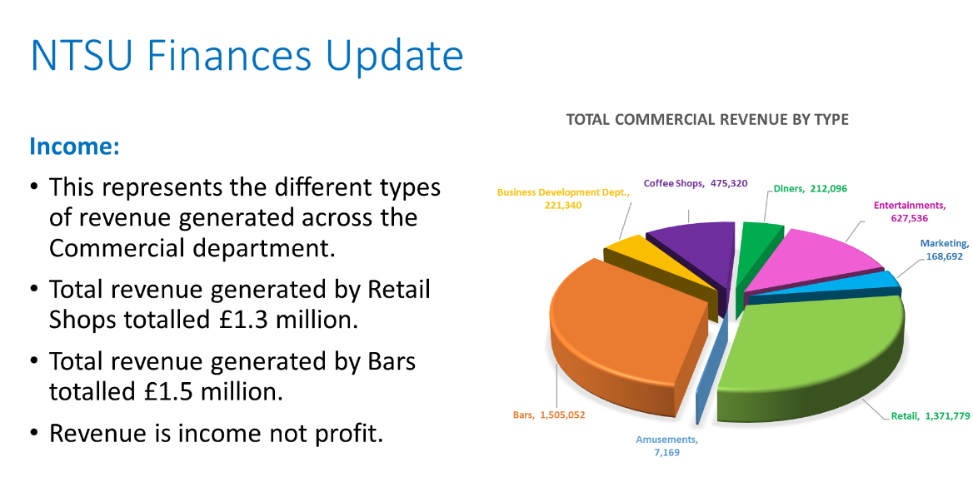

Slide 21
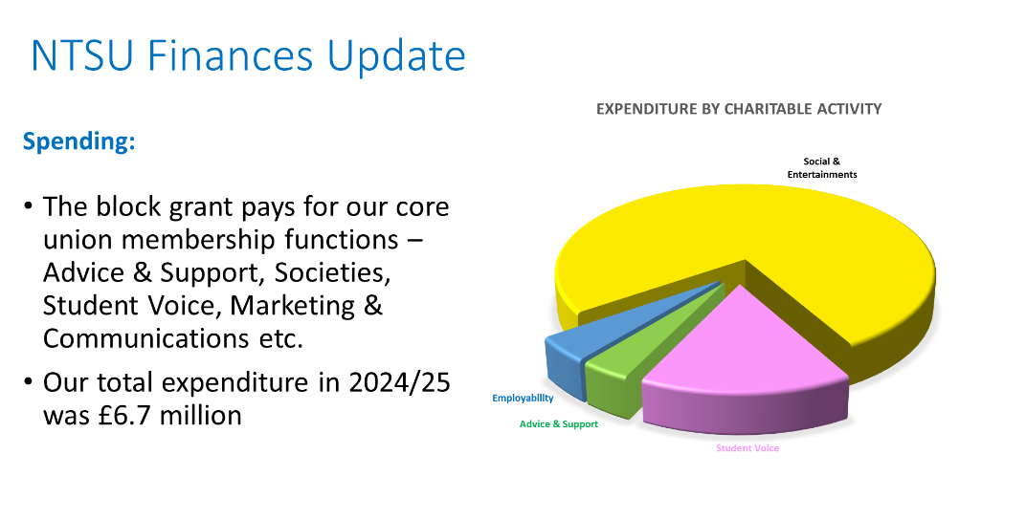

Slide 22
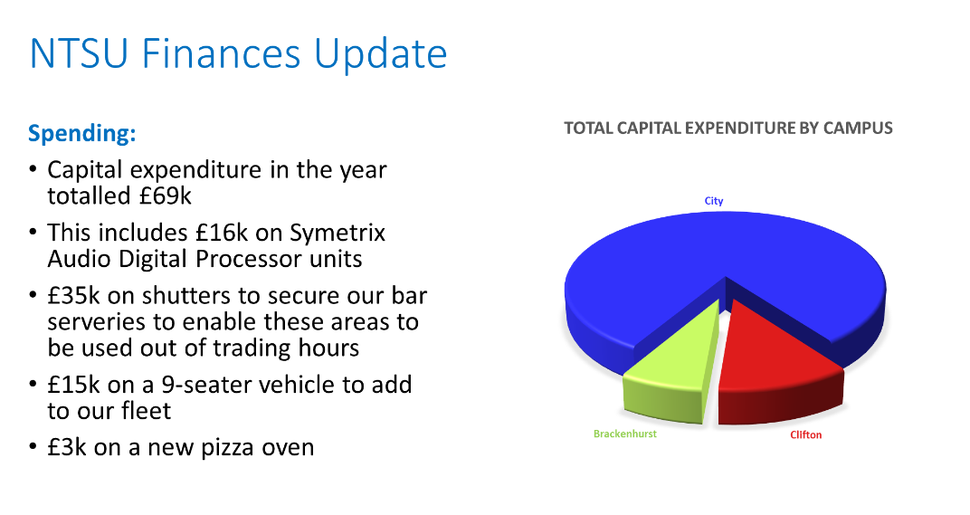

Slide 23
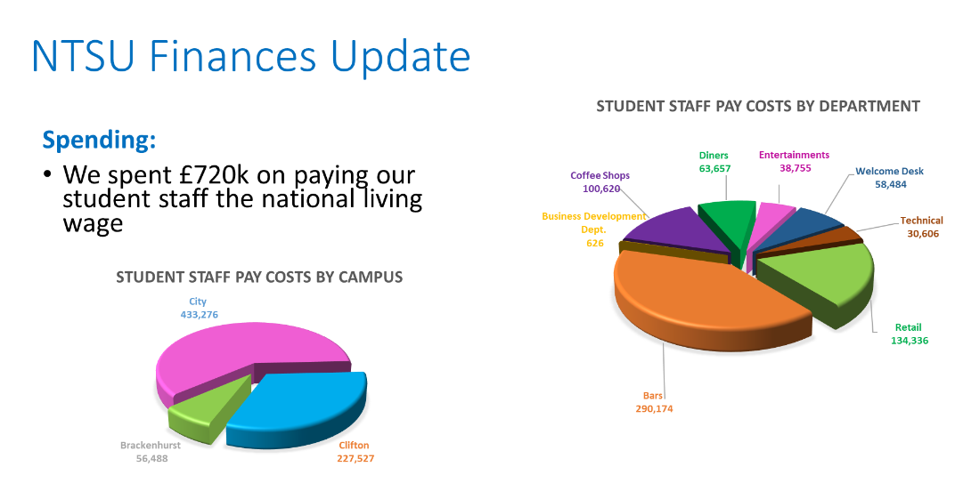

Slide 24
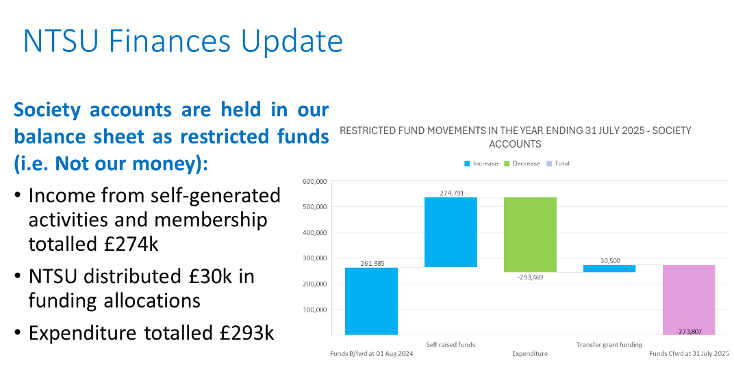

Slide 25
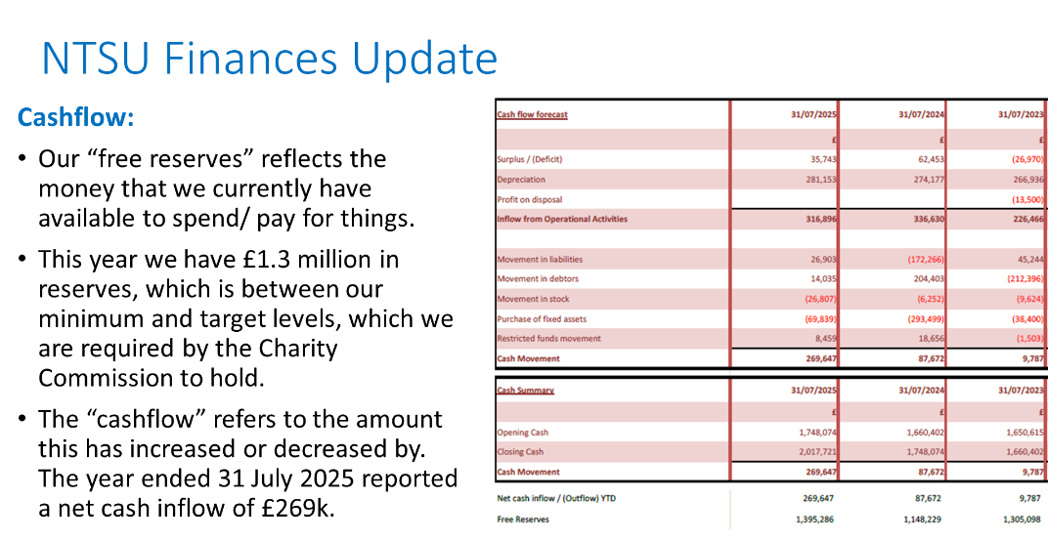

Slide 26
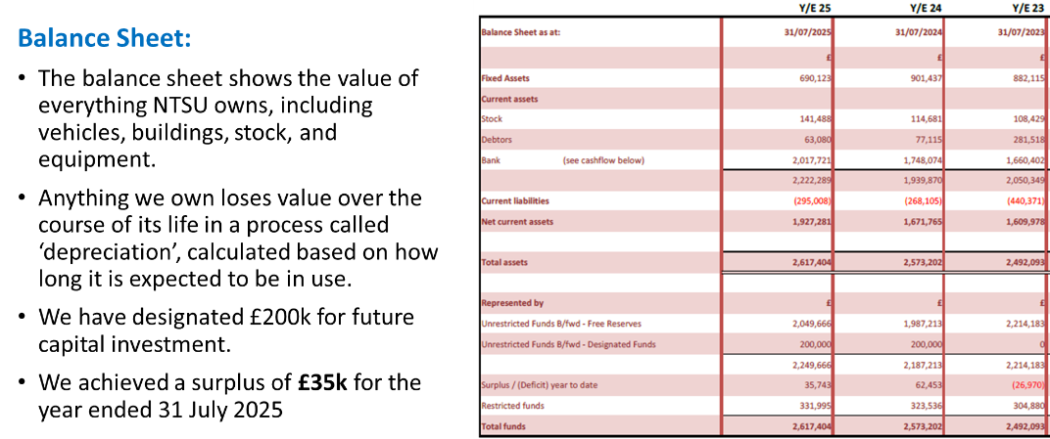

Slide 27
NTSU Affiliations
National Union of Students (United Kingdom)
Built into our budget is an affiliation to the National Union of Students (United Kingdom). NTSU is currently paying £37,500.00 annually.
NUS UK leads national campaigning and representative work, which supports the work of our officers here at NTSU.
Please note that, since 2020, NUS officially split into two organisations: NUS UK and NUS Charity, making our access to NUS Charity’s services and resources available regardless of NTSU’s affiliation with NUS UK.

Slide 28
NTSU Affiliations
National Union of Students (United Kingdom)
Please also note that, NTSU’s access to NUS Services LTD (NUSSL), a purchasing group, would not be affected regardless of the affiliation between NTSU and NUS UK. However, such access and trading through NUSSL does allow NTSU to get a better deal than regular trading groups, thus providing more value for money.

Slide 29
NTSU Officer Review
Part 1: Reshaping officer team to four core roles
NTSU are proposing to move to a 4-person Sabbatical Officer Structure
This new structure will be as follows:
  President
  Vice President Education
  Vice President Societies and Sports
  Vice President Community and Welfare
These roles have been selected based on student consultation and the priorities laid out in Officer Manifestos over recent elections.
This change will open funding for new paid, appointed student opportunities at NTSU (Part 2 & Part 3)

Slide 30
NTSU Officer Review
Part 2: Introduce paid UG and PG school officers for each school
Over the last three years we have recruited our School Officers through an application and interview process. We are proposing these volunteer positions become part time paid opportunities with one UG Officer and one PG Officer for the following schools:
  Architecture, Design and the Built Environment (ADBE)
  Nottingham Business School (NBS)
  Nottingham Law School (NLS)
  Nottingham School of Art & Design (A&D)
  Science & Technology (SST)
  School of Social Sciences (S3)
  Animal, Rural and Environmental Sciences (ARES)*
*We will also be changing the ARES PG and UG School Officers to Brackenhurst School Officers

Slide 31
NTSU Officer Review
Part 3: Introduce part time paid officers on our satellite campuses
The two Brackenhurst School Officers will replace the singular Brackenhurst Officer Role.
These two positions will focus on academic representation and the wider Brackenhurst Campus experience, from an undergraduate and postgraduate perspective.
We intend to provide paid opportunities for our other satellite campus roles:
  Mansfield Officer
  NTU London Officer
These roles will also be filled through an interview process led by the Officer Team, with a student panel from each respective campus.

Slide 32
NTSU Officer Review
Part 1: Reshaping officer team to four core roles
  President
  Vice President Education
  Vice President Societies and Sports
  Vice President Community and Welfare
Part 2: Introduce paid UG and PG school officers for each school
  Architecture, Design and the Built Environment (ADBE)
  Nottingham Business School (NBS)
  Nottingham Law School (NLS)
  Nottingham School of Art & Design (A&D)
  Science & Technology (SST)
  School of Social Sciences (S3)
  Brackenhurst
Broaden the Job Description of the Brackenhurst School Officers to cover the wider campus experience, replacing the Brackenhurst Officer
Part 3: Introduce part time paid officers on our satellite campuses
    Mansfield
    NTU London

Slide 33


Slide 34
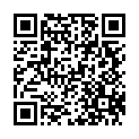
Make a Change

Slide 35
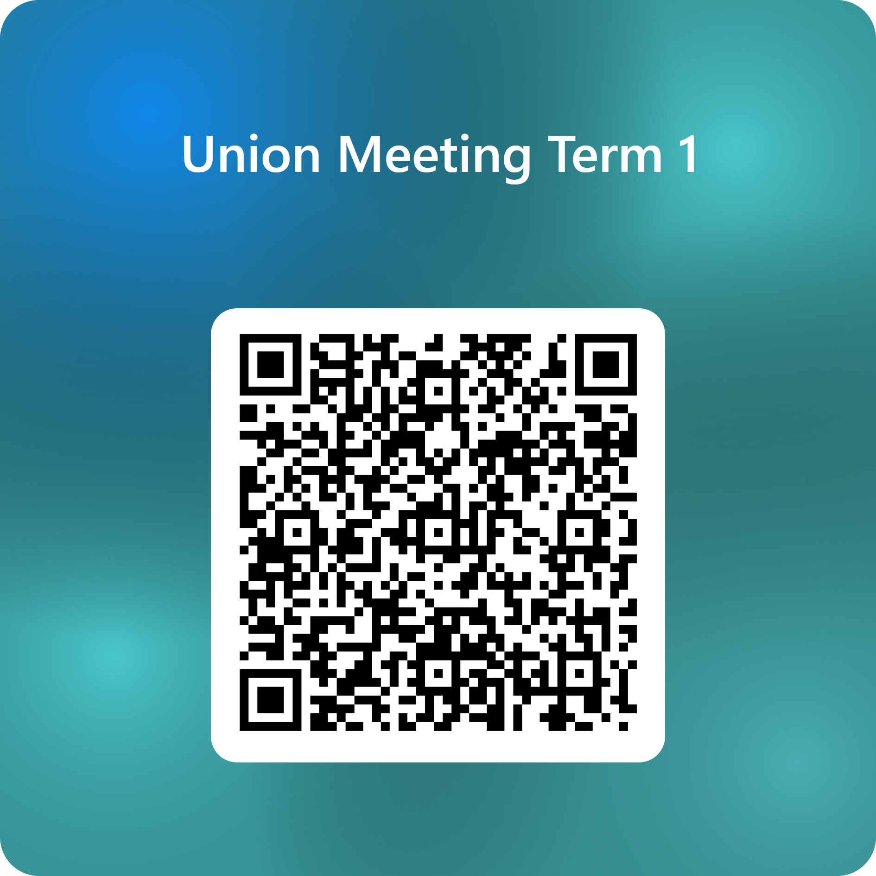
What is the Biggest Concern for you this year?

